Slide 1
Computer graphics
Semester 5 – Department of Informatics ITS 2016

Slide 2
Outline
Review Materi Minggu 4
Objek Primitif di OpenGL
Sesi 1: Three Dimensions
Sesi 2: Input and Interactions

Slide 3
Review: OpenGL Primitives
GL_POINTS
GL_LINES
GL_LINE_STRIP
GL_LINE_LOOP
GL_TRIANGLES
GL_TRIANGLE_STRIP
GL_TRIANGLE_FAN

Slide 4
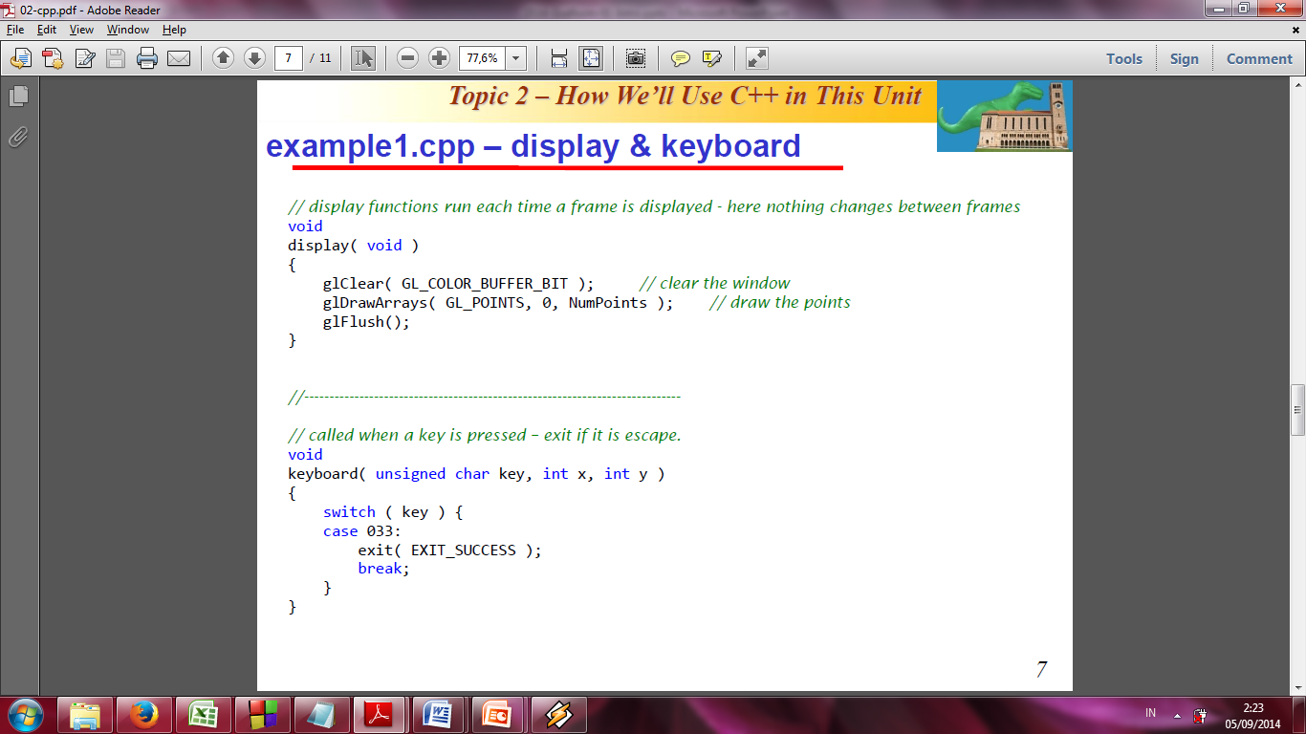
Review: Menampilkan objek primitif di Modern OpenGL
Objek primitif di OpenGL dispesifikasikan dengan kumpulan verteks.
Setelah data verteks dihitung dan disimpan dalam array, program mengirim data tsb ke GPU.
Saat ingin ditampilkan objek geometri tertentu, fungsi dengan parameter objek primitif tsb dieksekusi.
Contoh apabila verteks Sierpinski gasket ingin digambar sebagai sebuah titik maka fungsi berikut dipanggil setelah data verteks telah dikirim ke GPUL:
glDrawArrays(GL_POINTS, 0, NumPoints);

Slide 5
Review: Setting Colors
Colors are ultimately set in the fragment shader but can be determined in either shader or in the application
Application color: pass to vertex shader as a uniform variable or as a vertex attribute
Vertex shader color: pass to fragment shader as varying variable
Fragment color: can alter via shader code

Slide 6
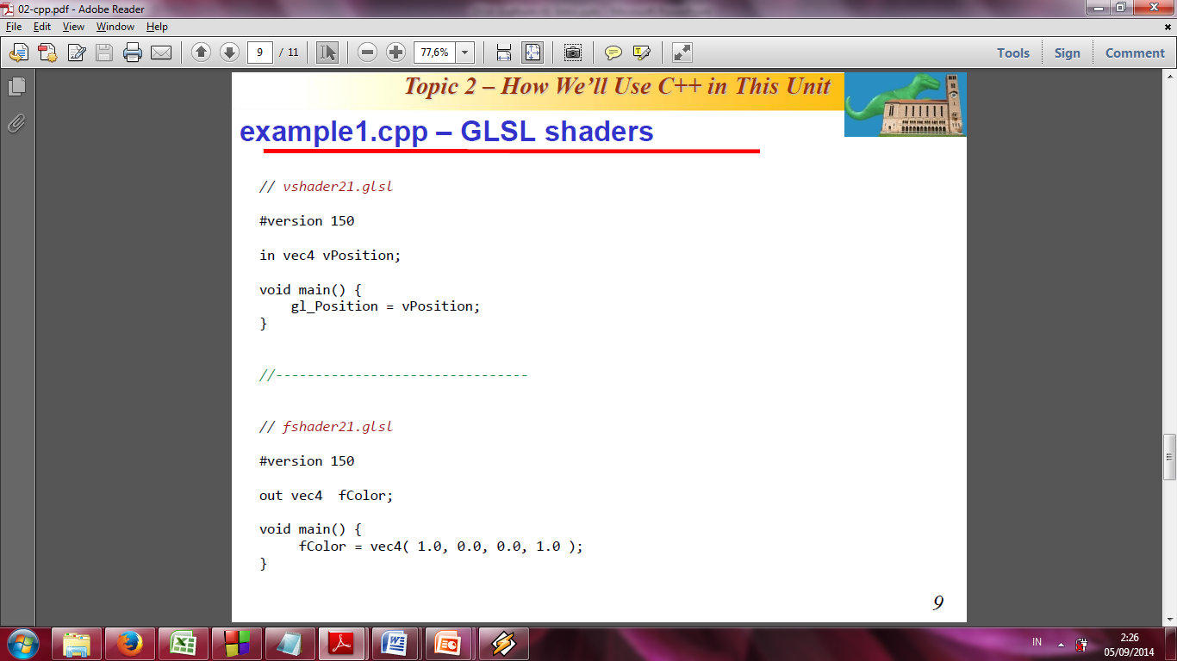
Review: Example1.cpp – GLSL shaders
In example1.cpp, colors are ultimately set in the fragment shader:

Slide 7
Review: Linking Shaders with Application
Read shaders
Compile shaders
Create a program object
Link everything together
Link variables in application with variables in shaders
Vertex attributes
Uniform variables

Slide 8
Review: Reading a Shader
Shaders are added to the program object and compiled
Usual method of passing a shader is as a null-terminated string using the function glShaderSource
If the shader is in a file, we can write a reader to convert the file to a string

Slide 9
Adding Color
If we set a color in the application, we can send it to the shaders as a vertex attribute or as a uniform variable depending on how often it changes
Let’s associate a color with each vertex
Set up an array of same size as positions
Send to GPU as a vertex buffer object

Slide 10
Setting Colors
typedef vec3 color3;
color3 base_colors[4] = {color3(1.0, 0.0, 0.0), ….
color3 colors[NumVertices];
vec3 points[NumVertices];
//in loop setting positions
colors[i] = basecolors[color_index]
position[i] = …….

Slide 11
Setting Up Buffer Object
//need larger buffer
glBufferData(GL_ARRAY_BUFFER, sizeof(points) + sizeof(colors), NULL, GL_STATIC_DRAW);
//load data separately
glBufferSubData(GL_ARRAY_BUFFER, 0, sizeof(points), points);
glBufferSubData(GL_ARRAY_BUFFER, sizeof(points), sizeof(colors), colors);

Slide 12
Second Vertex Array
// vPosition and vColor identifiers in vertex shader
loc = glGetAttribLocation(program, “vPosition”);
glEnableVertexAttribArray(loc);
glVertexAttribPointer(loc, 3, GL_FLOAT, GL_FALSE, 0, BUFFER_OFFSET(0));
loc2 = glGetAttribLocation(program, “vColor”);
glEnableVertexAttribArray(loc2);
glVertexAttribPointer(loc2, 3, GL_FLOAT, GL_FALSE, 0,
BUFFER_OFFSET(sizeofpoints));

Slide 13
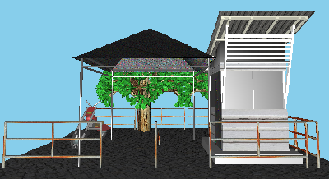
Session 1: Three Dimensions

Slide 14
Objectives
Develop a more sophisticated three-dimensional example
Sierpinski gasket: a fractal
Introduce hidden-surface removal

Slide 15
Three-dimensional Applications
In OpenGL, two-dimensional applications are a special case of three-dimensional graphics
Going to 3D
Not much changes
Use vec3, glUniform3f
Have to worry about the order in which primitives are rendered or use hidden-surface removal

Slide 16
Sierpinski Gasket (2D)
Start with a triangle
Connect bisectors of sides and remove central triangle
Repeat

Slide 17
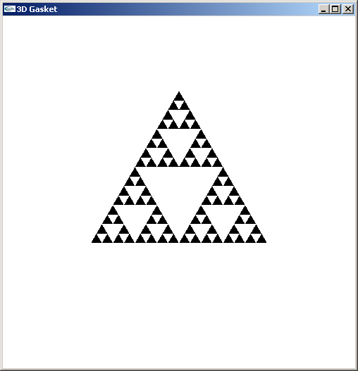
Example
Four subdivisions

Slide 18
The gasket as a fractal
Consider the filled area (black) and the perimeter (the length of all the lines around the filled triangles)
As we continue subdividing
the area goes to zero
but the perimeter goes to infinity
This is not an ordinary geometric object
It is neither two- nor three-dimensional
It is a fractal (fractional dimension) object

Slide 19
Gasket Program
/* see example2.cpp */
#include <GL/glut.h>
/* initial triangle */
vec2 v[3]={ vec2(-1.0, -0.58),
vec2(1.0, -0.58),
vec2(0.0, 1.15) };
int n=4; /* number of recursive steps */

Slide 20
Draw one triangle
void triangle(point2 a, point2 b, point2 c)
/* display one triangle */
{
static int i =0;
points[i++] = a;
points[i++] = b;
points[i++] = c;
}

Slide 21
Triangle Subdivision
void divide_triangle(point2 a, point2 b, point2 c, int m)
{
/* triangle subdivision using vertex numbers */
point2 ab, ac, bc;
if(m>0)
{
ab = (a + b )/2;
ac = (a + c)/2;
bc = (b + c)/2;
divide_triangle(a, ab, ac, m-1);
divide_triangle(c, ac, bc, m-1);
divide_triangle(b, bc, ac, m-1);
}
else(triangle(a,b,c));
/* draw triangle at end of recursion */
}

Slide 22
display and init Functions
void display()
{
glClear(GL_COLOR_BUFFER_BIT);
glDrawArrays(GL_TRIANGLES, 0, NumVertices);
glFlush();
}
void myinit()
{
vec2 v[3] = {vec2(……
.
.
divide_triangles(v[0], v[1], v[2], n);
.
.
}

Slide 23
main Function
int main(int argc, char **argv)
{
glutInit(&argc, argv);
glutInitDisplayMode(GLUT_SINGLE|GLUT_RGB);
glutInitWindowSize(500, 500);
glutCreateWindow(“2D Gasket");
glutDisplayFunc(display);
myinit();
glutMainLoop();
}

Slide 24
Moving to 3D
We can easily make the program three-dimensional by using
vec3 v[3]
and we start with a tetrahedron with four triangular faces
then we divide up each face separately,
and draw using a different color for each of the four faces

Slide 25
3D Gasket
We can subdivide each of the four faces
Appears as if we remove a solid tetrahedron from the center leaving four smaller tetrahedra
Code almost identical to 2D example

Slide 26
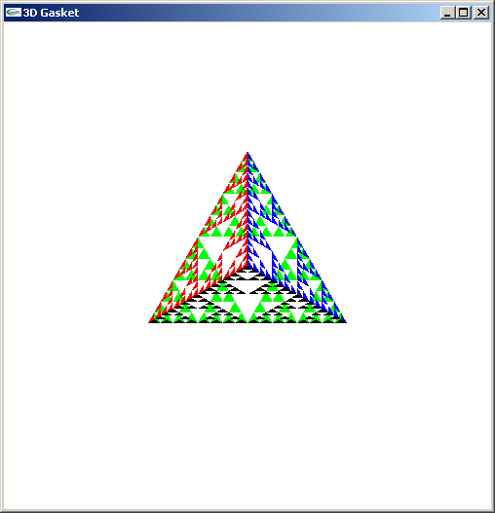
Example
after 5 iterations

Slide 27
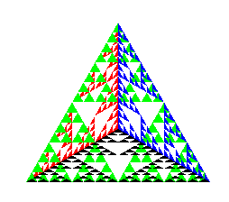
Almost Correct
Because the triangles are drawn in the order they are defined in the program, the front triangles are not always rendered in front of triangles behind them
get this
want this

Slide 28
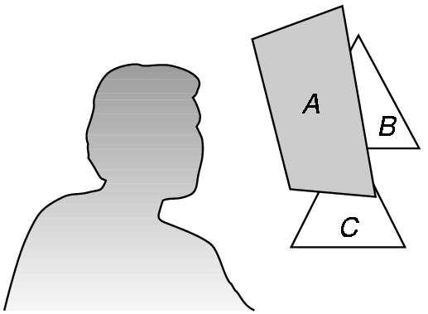
Hidden-Surface Removal
We want to see only those surfaces in front of other surfaces
OpenGL uses a hidden-surface method called the z-buffer algorithm that saves depth information as objects are rendered so that only the front objects appear in the image

Slide 29
Using the z-buffer algorithm
The algorithm uses an extra buffer, the z-buffer, to store depth information as geometry travels down the pipeline
The z-buffer must be
Requested in main.c
glutInitDisplayMode
(GLUT_SINGLE | GLUT_RGB | GLUT_DEPTH)
Enabled in init.c
glEnable(GL_DEPTH_TEST)
Cleared in the display callback
glClear(GL_COLOR_BUFFER_BIT |
GL_DEPTH_BUFFER_BIT)

Slide 30
Surface vs Volume Subdvision
In our example, we divided the surface of each face
We could also divide the volume using the same midpoints
The midpoints define four smaller tetrahedrons, one for each vertex
Keeping only these tetrahedrons removes a volume in the middle
See text for code

Slide 31
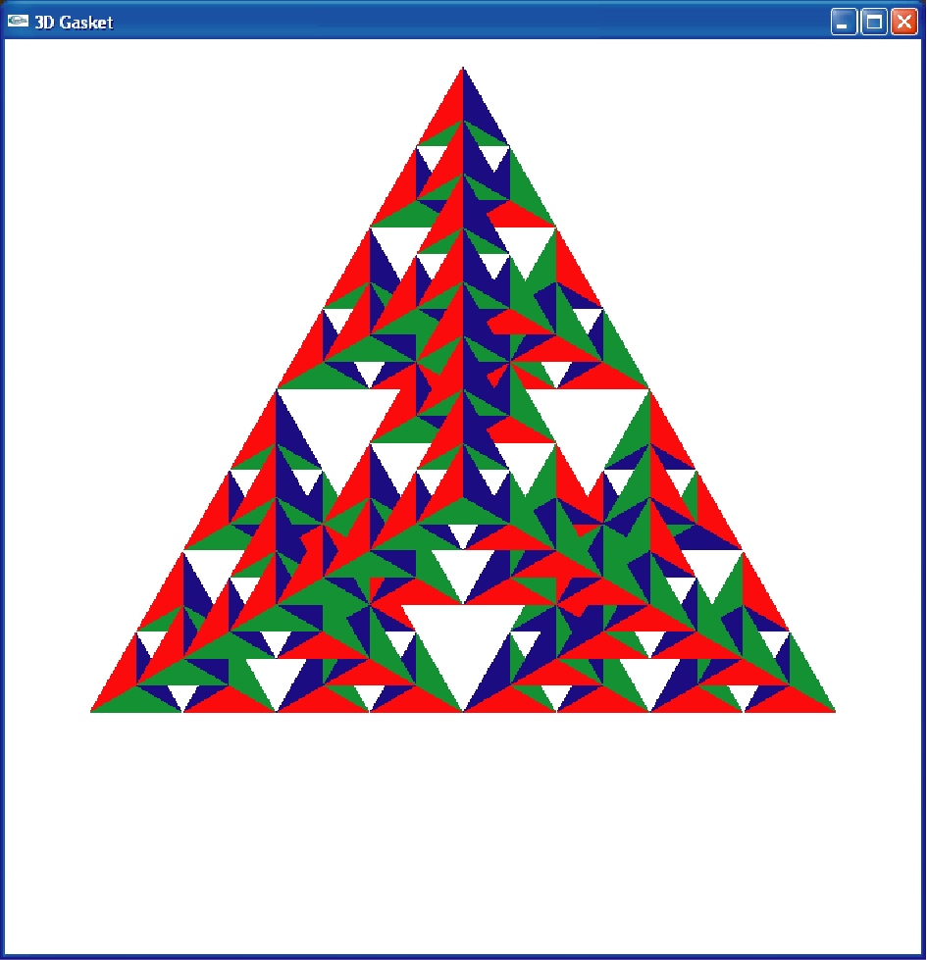
Volume Subdivision

Slide 32
Session 2: Input and Interaction

Slide 33
Objectives
Introduce the basic input devices
Physical Devices
Logical Devices
Input Modes
Event-driven input
Introduce double buffering for smooth animations
Programming event input with GLUT

Slide 34
Project Sketchpad
Ivan Sutherland (MIT 1963) established the basic interactive paradigm that characterizes interactive computer graphics:
User sees an object on the display
User points to (picks) the object with an input device (light pen, mouse, trackball)
Object changes (moves, rotates, morphs)
Repeat

Slide 35
Graphical Input
Devices can be described either by
Physical properties
Mouse
Keyboard
Trackball
Logical Properties
What is returned to program via API
A position
An object identifier
Modes
How and when input is obtained
Request or event

Slide 36
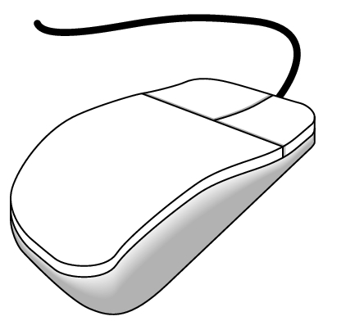
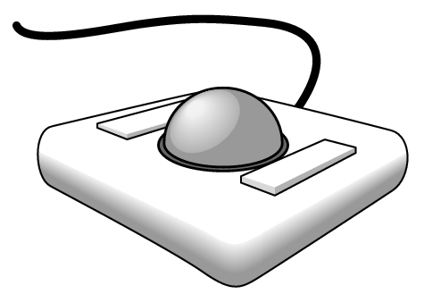
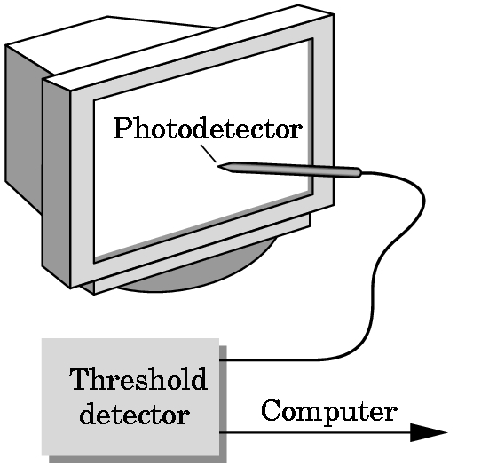
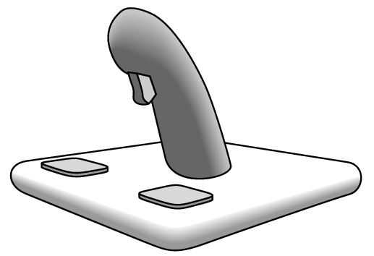
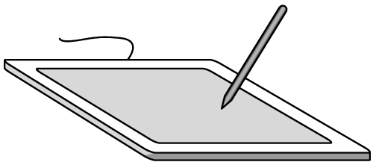
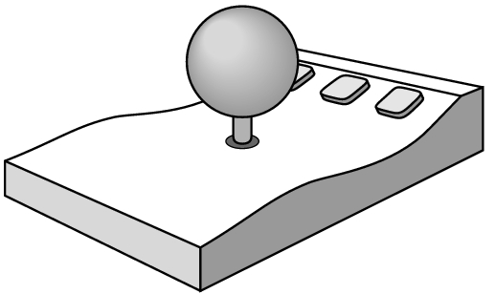
Physical Devices
mouse
trackball
light pen
data tablet
joy stick
space ball

Slide 37
Incremental (Relative) Devices
Devices such as the data tablet return a position directly to the operating system
Devices such as the mouse, trackball, and joy stick return incremental inputs (or velocities) to the operating system
Must integrate these inputs to obtain an absolute position
Rotation of cylinders in mouse
Roll of trackball
Difficult to obtain absolute position
Can get variable sensitivity

Slide 38
Logical Devices
Consider the C and C++ code
C++: cin >> x;
C: scanf (“%d”, &x);
What is the input device?
Can’t tell from the code
Could be keyboard, file, output from another program
The code provides logical input
A number (an int) is returned to the program regardless of the physical device

Slide 39
Graphical Logical Devices
Graphical input is more varied than input to standard programs which is usually numbers, characters, or bits
Two older APIs (GKS, PHIGS) defined six types of logical input
Locator: return a position
Pick: return ID of an object
Keyboard: return strings of characters
Stroke: return array of positions
Valuator: return floating point number
Choice: return one of n items

Slide 40
Input Modes
Input devices contain a trigger which can be used to send a signal to the operating system
Button on mouse
Pressing or releasing a key
When triggered, input devices return information (their measure) to the system
Mouse returns position information
Keyboard returns ASCII code

Slide 41

Request Mode
Input provided to program only when user triggers the device
Typical of keyboard input
Can erase (backspace), edit, correct until enter (return) key (the trigger) is depressed

Slide 42

Event Mode
Most systems have more than one input device, each of which can be triggered at an arbitrary time by a user
Each trigger generates an event whose measure is put in an event queue which can be examined by the user program

Slide 43
Event Types
Window: resize, expose, iconify
Mouse: click one or more buttons
Motion: move mouse
Keyboard: press or release a key
Idle: nonevent
Define what should be done if no other event is in queue

Slide 44
Callbacks
Programming interface for event-driven input
Define a callback function for each type of event the graphics system recognizes
This user-supplied function is executed when the event occurs
GLUT example: glutMouseFunc(mymouse)
mouse callback function

Slide 45
GLUT callbacks
GLUT recognizes a subset of the events recognized by any particular window system (Windows, X, Macintosh)
glutDisplayFunc
glutMouseFunc
glutReshapeFunc
glutKeyboardFunc
glutIdleFunc
glutMotionFunc, glutPassiveMotionFunc

Slide 46
GLUT Event Loop
Recall that the last line in main.c for a program using GLUT must be
glutMainLoop();
which puts the program in an infinite event loop
In each pass through the event loop, GLUT
looks at the events in the queue
for each event in the queue, GLUT executes the appropriate callback function if one is defined
if no callback is defined for the event, the event is ignored

Slide 47
The display callback
The display callback is executed whenever GLUT determines that the window should be refreshed, for example
When the window is first opened
When the window is reshaped
When a window is exposed
When the user program decides it wants to change the display
In main.c
glutDisplayFunc(mydisplay) identifies the function to be executed
Every GLUT program must have a display callback

Slide 48
Posting redisplays
Many events may invoke the display callback function
Can lead to multiple executions of the display callback on a single pass through the event loop
We can avoid this problem by instead using
glutPostRedisplay();
which sets a flag.
GLUT checks to see if the flag is set at the end of the event loop
If set then the display callback function is executed

Slide 49
Working with Callbacks

Slide 50
Objectives
Learn to build interactive programs using GLUT callbacks
Mouse
Keyboard
Reshape
Introduce menus in GLUT

Slide 51
The mouse callback
glutMouseFunc(mymouse)
void mymouse(GLint button, GLint state, GLint x, GLint y)
Returns
which button (GLUT_LEFT_BUTTON, GLUT_MIDDLE_BUTTON, GLUT_RIGHT_BUTTON) caused event state of that button (GLUT_UP, GLUT_DOWN)
Position in window

Slide 52
Positioning
The position in the screen window is usually measured in pixels with the origin at the top-left corner
Consequence of refresh done from top to bottom
OpenGL uses a world coordinate system with origin at the bottom left
Must invert y coordinate returned by callback by height of window
y = h – y;
(0,0)
h
w

Slide 53
Obtaining the window size
To invert the y position we need the window height
Height can change during program execution
Track with a global variable
New height returned to reshape callback that we will look at in detail soon
Can also use query functions
glGetIntv
glGetFloatv
to obtain any value that is part of the state

Slide 54
Terminating a program
In our original programs, there was no way to terminate them through OpenGL
We can use the simple mouse callback
void mouse(int btn, int state, int x, int y)
{
if(btn==GLUT_RIGHT_BUTTON && state==GLUT_DOWN)
exit(0);
}

Slide 55
Using the mouse position
In the next example, we draw a small square at the location of the mouse each time the left mouse button is clicked
This example does not use the display callback but one is required by GLUT; We can use the empty display callback function
mydisplay(){}

Slide 56
Drawing squares at cursor location
void mymouse(int btn, int state, int x, int y)
{
if(btn==GLUT_RIGHT_BUTTON && state==GLUT_DOWN)
exit(0);
if(btn==GLUT_LEFT_BUTTON && state==GLUT_DOWN)
drawSquare(x, y);
}
void drawSquare(int x, int y)
{
y=w-y; /* invert y position */
points[i] = point2(x+size, y+size);
points[i+1] = point2(x-size, y+size);
points[i+2] = point2(x-size, y-size);
points[i+3] = point2 x+size, y-size);
i+=4
}

Slide 57
Using the motion callback
We can draw squares (or anything else) continuously as long as a mouse button is depressed by using the motion callback
glutMotionFunc(drawSquare)
We can draw squares without depressing a button using the passive motion callback
glutPassiveMotionFunc(drawSquare)

Slide 58
Using the keyboard
glutKeyboardFunc(mykey)
void mykey(unsigned char key,
int x, int y)
Returns ASCII code of key depressed and mouse location
void mykey(unsigned char key, int x, int y)
{
if(key == ‘Q’ | key == ‘q’)
exit(0);
}

Slide 59
Special and Modifier Keys
GLUT defines the special keys in glut.h
Function key 1: GLUT_KEY_F1
Up arrow key: GLUT_KEY_UP
if(key == ‘GLUT_KEY_F1’ ……
Can also check of one of the modifiers
GLUT_ACTIVE_SHIFT
GLUT_ACTIVE_CTRL
GLUT_ACTIVE_ALT
is depressed by
glutGetModifiers()
Allows emulation of three-button mouse with one- or two-button mice

Slide 60
Reshaping the window
We can reshape and resize the OpenGL display window by pulling the corner of the window
What happens to the display?
Must redraw from application
Two possibilities
Display part of world
Display whole world but force to fit in new window
Can alter aspect ratio

Slide 61
Reshape possiblities
original
reshaped

Slide 62
The Reshape callback
glutReshapeFunc(myreshape)
void myreshape( int w, int h)
Returns width and height of new window (in pixels)
A redisplay is posted automatically at end of execution of the callback
GLUT has a default reshape callback but you probably want to define your own
The reshape callback is good place to put viewing functions because it is invoked when the window is first opened

Slide 63
Toolkits and Widgets
Most window systems provide a toolkit or library of functions for building user interfaces that use special types of windows called widgets
Widget sets include tools such as
Menus
Slidebars
Dials
Input boxes
But toolkits tend to be platform dependent
GLUT provides a few widgets including menus

Slide 64
Menus
GLUT supports pop-up menus
A menu can have submenus
Three steps
Define entries for the menu
Define action for each menu item
Action carried out if entry selected
Attach menu to a mouse button

Slide 65
Defining a simple menu
In main.c
menu_id = glutCreateMenu(mymenu);
glutAddmenuEntry(“clear Screen”, 1);
gluAddMenuEntry(“exit”, 2);
glutAttachMenu(GLUT_RIGHT_BUTTON);
clear screen
exit
entries that appear when
right button depressed
identifiers

Slide 66
Menu actions
Menu callback
Note each menu has an id that is returned when it is created
Add submenus by
glutAddSubMenu(char *submenu_name, submenu id)
void mymenu(int id)
{
if(id == 1) glClear();
if(id == 2) exit(0);
}
entry in parent menu

Slide 67
Other functions in GLUT
Dynamic Windows
Create and destroy during execution
Subwindows
Multiple Windows
Changing callbacks during execution
Timers
Portable fonts (deprecated)

Slide 68
Next Week: Representation
Also Transformation
Read the Textbook Ch. 3

Slide 69
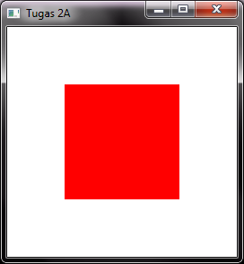
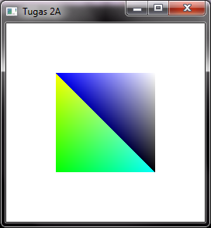
Task 4
In Task 3, you were able to draw triangles.
In Task 4:
Draw a square using two triangles
Use 3D data instead of 2D
Use different color for each corner

Slide 70
Hints
Untuk menggambar sebuah persegi dengan dua segitiga dapat digunakan code berikut ini:
Pada program ini digunakan sistem 3 dimensi,
Ubah tipe data argumen fungsi triangle dari vec2 menjadi vec3
Ubah argumen ke-2 pada saat memanggil fungsi glVertexAttribPointer dari 2 menjadi 3
Rebuild dan execute untuk menghasilkan gambar
const int NumTriangles = 2;
const int NumVertices = 3 * NumTriangles;
vec3 points[NumVertices] = {
vec3(-0.5, -0.5, 0.0), vec3(-0.5, 0.5, 0.0), vec3(0.5, -0.5, 0.0),
vec3(0.5, 0.5, 0.0), vec3(0.5, -0.5, 0.0), vec3(-0.5, 0.5, 0.0)
};

Slide 71
Hints
Tambahkan warna sejumlah verteks (setelah points)
Copy isi fungsi init dari example4.cpp mulai dari baris
// Create a vertex array object
Beri comment baris yang meng-enable depth test
glEnable( GL_DEPTH_TEST );
Ubah InitShader.cpp sesuai isi vshader24.glsl dan fshader24.glsl
Rebuild
Verifikasi bahwa setiap verteks sesuai warna yang ditentukan
Eksperimen dengan warna yang berbeda shg persegi tidak tampak tersusun atas 2 segitiga
vec3 colors[NumVertices] = {
vec3(0.0, 1.0, 0.0) /* Green, but choose any 6 colours */, ..., ...,
vec3(/* ... */), ..., ...
};

Slide 72
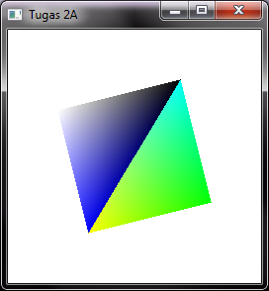
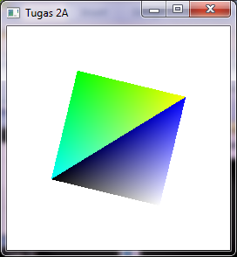
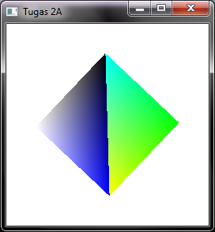
Task 5
Create a rotated square

Slide 73
Hints
Misal kita menginginkan kubus yang berotasi dengan sisi depannya tetap menghadap kita/kamera.
Jika kita mengubah semua posisi verteks, maka kita harus mengirim semua posisi yang baru tsb ke graphics hardware lagi(jika jumlah verteks sedikit bukan masalah, namun jika banyak maka hal ini sebaiknya dihindari).
Oleh karena itu, yang dikirim ke vertex shader bukan semua verteks, melainkan sudut rotasi, lalu vertex shader akan merotasi semua posisi verteks dengan sudut yang diberikan.
Bahkan kita bisa hanya mengirim waktu sejak program berjalan lalu shader yang akan memperbesar sudut rotasi seiring waktu berjalan.
Copy Project sebelumnya dan rename
Modifikasi isi vertex shader dengan menambahkan variabel time (sebelum main)
uniform float time; /* in milliseconds */
Ubah isi main pada vertex shader sehingga gl_Position dihitung dengan cara berikut:
float angle = 0.001*time;
gl_Position = vec4(vPosition.x*cos(angle) - vPosition.y*sin(angle), vPosition.x*sin(angle) + vPosition.y*cos(angle), 0.0, 1.0);

Slide 74
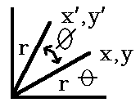
Rotasi 2D
Example of a 2D rotation through an angle w where the coordinates x, y go into x', y'.
Note that w is positive for a counterclockwise rotation and that that rotation is about the origin (0, 0).
Derive the formula for rotation
(old coordinates are (x, y) and the new coordinates are (x', y'))
q = initial angle, f = angle of rotation.
x = r cos q y = r sin q
x' = r cos ( q + f ) = r cos q cos f - r sin q sin f y' = r sin ( q + w ) = r sin q cos f + r cos q sin f
hence: x' = x cos f - y sin f y' = y cos f + x sin f

Slide 75
Hints
Tambahkan variabel global timeParam bertipe GLint
Pada fungsi init tambahkan baris berikut (setelah perintah load dan use shader)
timeParam = glGetUniformLocation(program, "time");
[Ini adalah variabel uniform yang berarti nilainya tidak akan berubah selama penggambaran sebuah primitive, sehingga tidak diperlukan array/buffer, berbeda dengan vPosition dan vColor.]
Pada fungsi display tambahkan baris berikut (sebelum memanggil glDrawArrays)
glUniform1f( timeParam, glutGet(GLUT_ELAPSED_TIME) );
[glUniform1f mengeset sebuah parameter uniform yang berisi sebuah nilai float menjadi sebuah nilai tertentu. Disini nilainya diisi dengan hasil pemanggilan fungsi glutGet(GLUT_ELAPSED_TIME) yaitu waktu dalam milisekon semenjak glutInit dipanggil.]
Tambahkan fungsi idle callback yang hanya berisi glutPostRedisplay().
Register fungsi idle tsb pada main dengan memanggil glutIdleFunc.
[Calling glutPostRedisplay tells GLUT that the window needs to be redisplayed. Here we call it in the idle function because there is constant motion, so we want to redisplay whenever GLUT/OpenGL has nothing else to do and is idle. The actual redisplay will happen at some point after the idle function returns, when GLUT is ready to redraw the window. More generally, if you only require redrawing when a mouse event causes an object to move, or similar, you should only call glutPostRedisplay() when such a change occurs. Calling it multiple times is fine if multiple changes occur before a redraw happens - it just sets a variable that GLUT uses to remember that a redraw is required.]
Gunakan double buffering
Rebuild
Eksperimen dengan meningkatkan kecepatan rotasinya. Bagaimana jika sudutnya dikuadratkan?

Slide 76
Next Week: Demo Tugas

